Slide 1
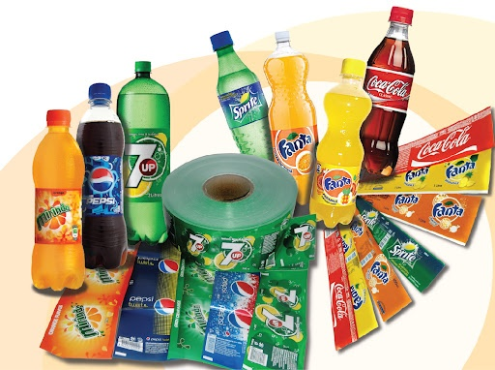
Category 1. (Wrap Around Label)
Wrap Around Label: | Surface Printed 38µ Pearl BOPP Surface Printed 38µ Transparent BOPP
Key Unique Process: Printing (ESA & Static Eliminator)
POTENTIAL CUSTOMER NAME
PEPSICO INDIA PVT. LTD.
COCA COLA INDIA
RASNA INTERNATIONAL
PARLE FOOD & BEVERAGES
SANJAY GODAVAT GROUP

Slide 2
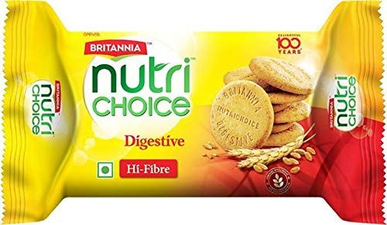
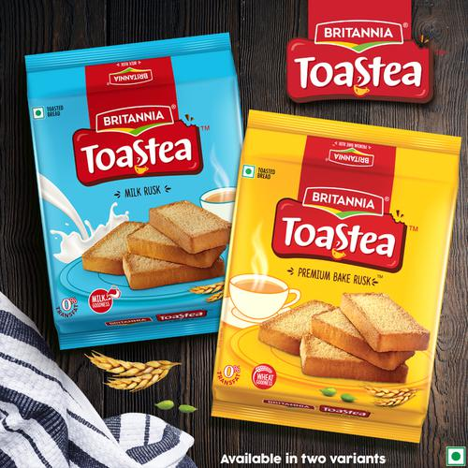
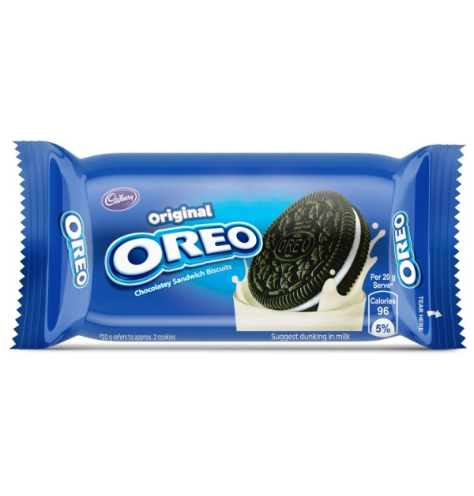
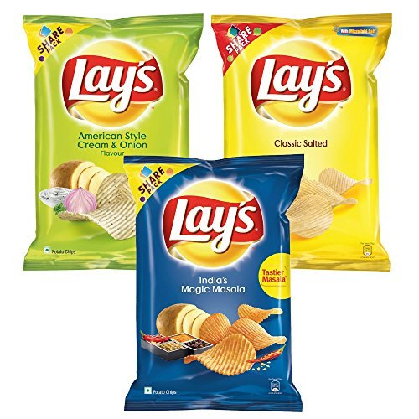
Category : 2 (Snacks)
Biscuits & Rusk: | 12BOPP + Ex + 18HMBOPP 12BOPP + 18HMBOPP 12BOPP + 18HMCPP
Key Unique Process: Extrusion Lamination
Potato chips & Namkeen: | 12CCPET + Ex + 12MPET + 20NPE 18BOPP + Ex + 12MPET + 20NPE
Key Unique Process: Extrusion Lamination

Slide 3

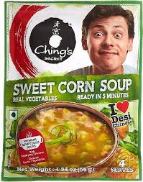
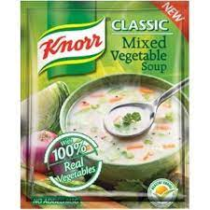
Category Code: 3
1. Milk Powder: | 10CCPET + Ex + 10MPET + 85NPE 12CCPET + 6.5µ Al foil + 40µ NPE
2. Soup powder: | 50gsm PAPER + Ex + 9FOIL + 50NPE
Key Unique Process: Extrusion Lamination
POTENTIAL CUSTOMER NAME
SAMRAT NAMKEEN
KATE FOODS INDUSTRIES PVT LTD.
ANMOL BISCUIT
DFM FOODS (CRAX)
HALDIRAM FOODS PVT LTD
RAVI FOODS PVT (DUKES INDIA)
PARLE AGRO INDIA LTD
BIKAJI NAMKEEN

Slide 4
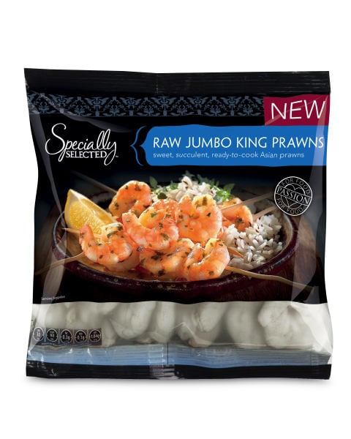
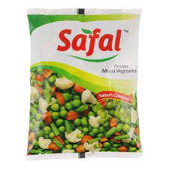
Category Code: 4 (Frozen Foods)
Frozen Vegetable's, Snacks : | 10CCPET + 85NYPE 15BOPA + 85NPE
Key Unique Process: 7Layer Blown Film Printing
POTENTIAL CUSTOMER NAME
ZINDAL FROZEN FOODS
ALLANA INDIA LTD.
MC CAIN FOODS
MOTHER DAIRY
AMUL

Slide 5
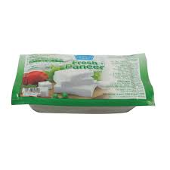
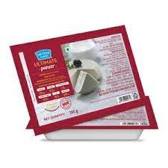
Category Code: 5 (Processed Milk Products)
Paneer Packaging | 15BOPA + 85NYPE
Key Unique Process: 7 Layer Blown Film Printing Solvent Base Lamination
POTENTIAL CUSTOMER NAME
MOTHER DAIRY
AMUL
VERKA
SANCHI
SARAS

Slide 6
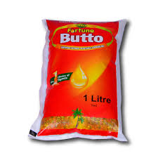
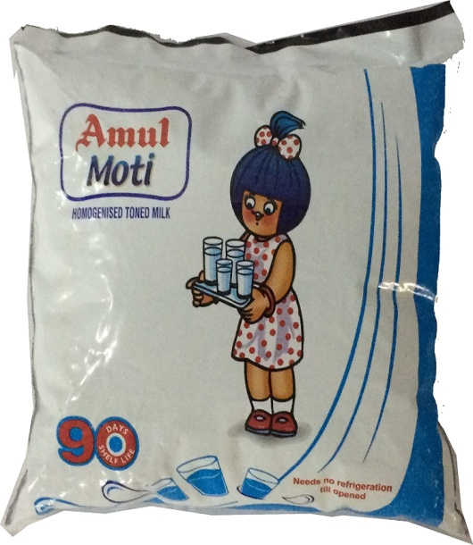
Category Code: 6 (Surface Printed Poly)
Edible Oil, Processed Milk Products : | 7 Layer 120 NYPE 7 Layer 80 NYEVOH PE
Key Unique Process: 1. 7 Layer Blown Film 2. Printing
POTENTIAL CUSTOMER NAME
ADANI WILMAR
GOKUL OIL
GULAB OIL
N.K.PROTEINS
ABIS EXPORTS (IB GROUP)

Slide 7
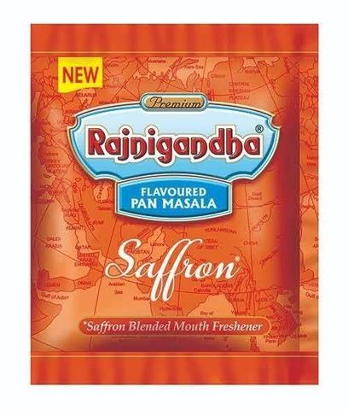
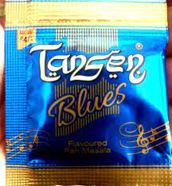
Category Code: 7 (Paper Foil)
Pan Masala & Tobacco Products: | 6.5FOIL + 40HSBK PAPER + 6.5FOIL + HSL
Key Unique Process: Lamination Coating Printing Lamination Slitting
POTENTIAL CUSTOMER NAME
DS GROUP
MIRACLE GROUP OF COMPANIES
SHUDH PLUS
VIMAL GROUP
KOTHARI GROUP

Slide 8
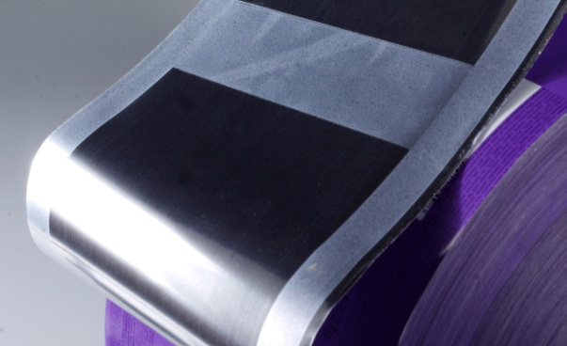

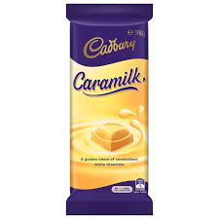
Category Code: 8
Chocolate Wrapper Outer: | 18BOPP + 12MPET + CS 30MBOPP + CS
Key Unique Process: Printing Lamination Combi 5000 Coating
POTENTIAL CUSTOMER NAME
CADBURRY
NESTLE
AMUL
SWEET WORLD GROUP
CHOCHOLICS

Slide 9
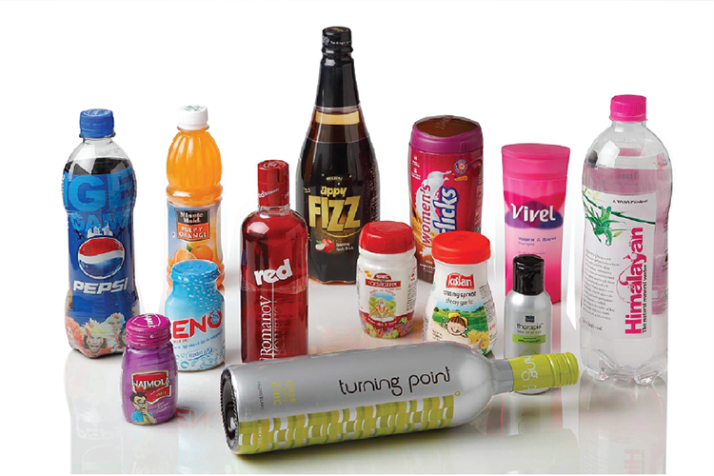

Category Code: 9
Shrink Sleeves: | Printed 40µ Shrink PVC Printed 40µ Shrink PET
Key Unique Process: 1. Printing 3. Seaming
POTENTIAL CUSTOMER NAME
PARLE AGRO INDIA LTD
EMAMI LTD
RASNA INTERNATIONAL
DAVAT BEVERAGES PVT LTD
COCA COLA LTD

Slide 10
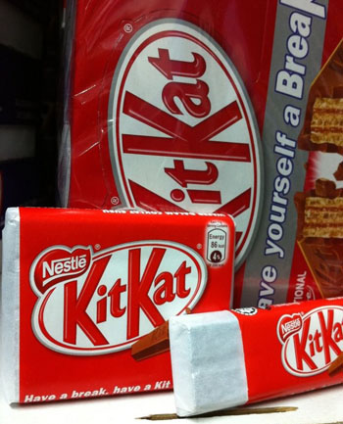
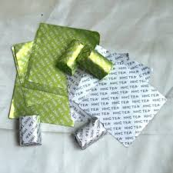
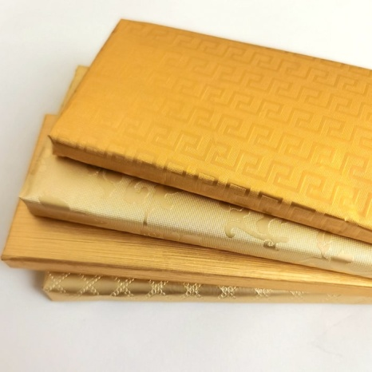
Category Code: 10
Chocolate Wrapper Inner: | 30 PAPER + 6.5FOIL
Key Unique Process: Lamination Printing Embossing Slitting
POTENTIAL CUSTOMER NAME
PARLE
NESTLE
MARS GROUP
HERSHEY'S
CADBURY

Slide 11
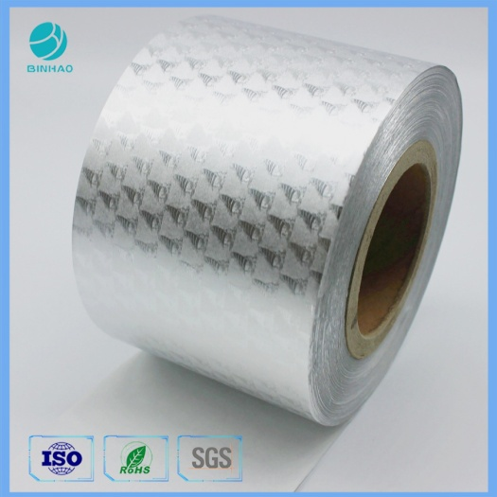
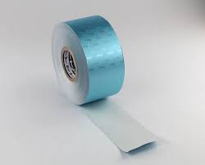
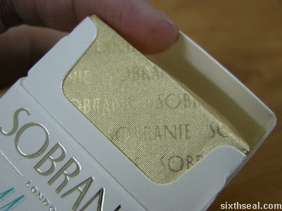
Category Code: 11 (Embossed Paper Foil)
Cigarette Wrapper & Gum Wrapper: | 30POSTER PAPER FG + 6.5FOIL
Key Unique Process: Lamination Combi 5000 Embossing Slitting
POTENTIAL CUSTOMER NAME
ITC LTD
GODFREY PHILLIPS INDIA LTD
NESTLE

Slide 12
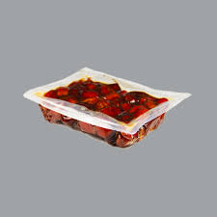
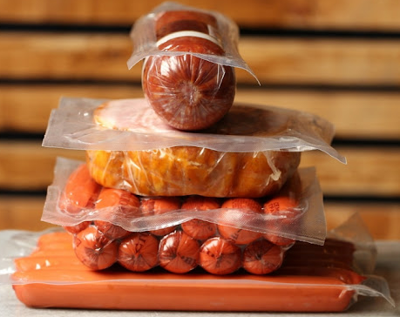
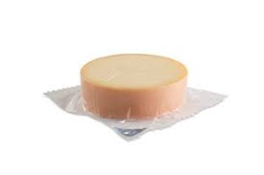
Category Code: 12
Thermoforming & Vacuum Packaging: | 120µ NYEVPE 225 µNYEVPE
Key Unique Process: 7 Layer Blown Film
POTENTIAL CUSTOMER NAME
MOLVIZADAH SONS
RUSTOM FOODS PVT LTD
TRANS AGRO PVT. LTD.

Slide 13
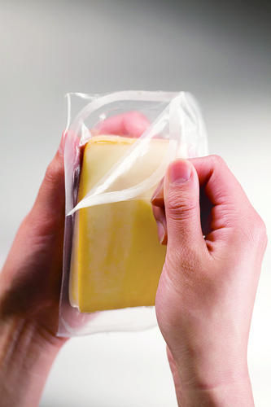
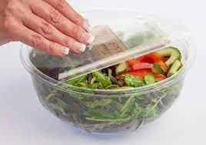
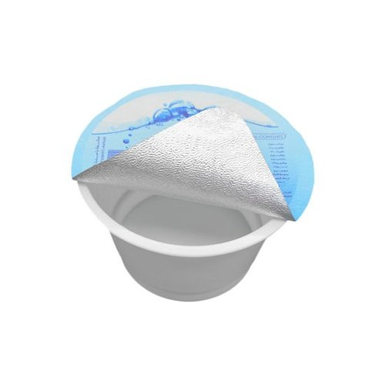
Category Code: 13
Easy Peel Film (Lidding Film): | 12CTPET + 40NPE EPL 38AL FOIL + 40NPE EPL 38AL FOIL + EPL
Key Unique Process: 3 L Blown Film Extrusion Coating
POTENTIAL CUSTOMER NAME
KARNATAKA MILK FEDERATION
MILK MISTY DAIRY FOODS PVT LTD
TELANGANA DAIRY CO-OP. FED.

Slide 14

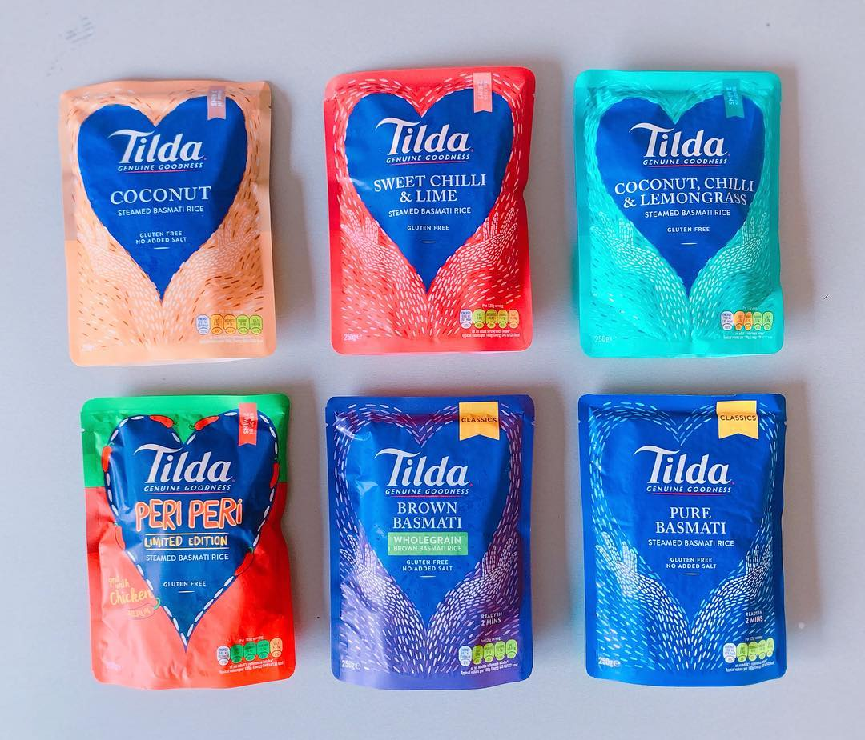
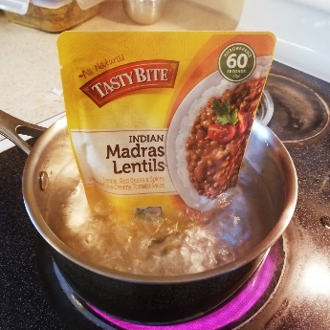
Category Code: 14
Retort Pouches | 12HRPET + 09Al Foil + 15BOPA + 70RCPP 13AloxPET + 15BOPA + 70RCPP
Key Unique Process: Printing Lamination Pouching Dust Free Infra structure
POTENTIAL CUSTOMER NAME
HINDUSTAN UNILEVER LTD
ADF FOODS
CAPITAL FOODS PVT LTD

Slide 15
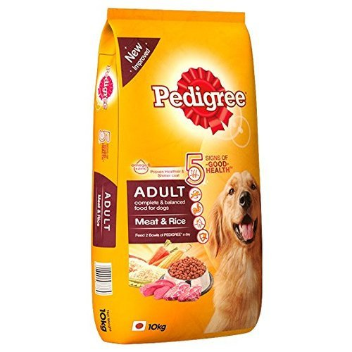
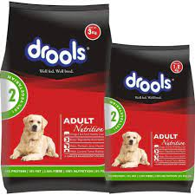
Category Code: 15
PET Food Packaging | 12CCPET + 80NPE 12CCPET + 10MPET + 55NPE 55NPE + 90WPE
Key Unique Process: Printing-Double Drying Hood Lamination Combi 5000
POTENTIAL CUSTOMER NAME
PEDIGREE
CARGILL
ABIS EXPORT (IB GROUP)

Slide 16
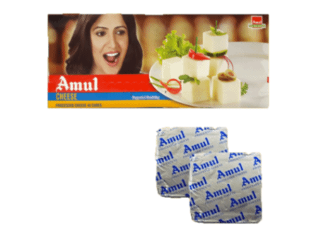
Category Code: 16
Coated Foil (Cheese chip lets) | Coating + 12FOIL+ HSL
Key Unique Process Lamination: Combi 5000
POTENTIAL CUSTOMER NAME
AMUL
MOTHER DAIRY
SONAI GROUP

Slide 17
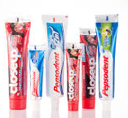


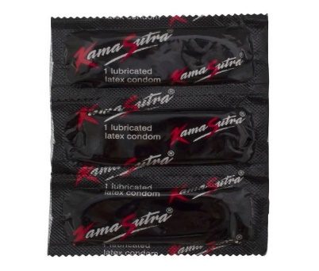
Category Code: 17 (Key Unique Process: Extrusion Lamination)
1. Tube laminate | 110NPE + EX + 9FOIL + EX + 80NPE 130WHPE + EX + 70EVOH + EX + 80NPE
2. Contraceptive Packaging: | 12CC PET + EX + 9FOIL + EX SUR 40gsm GLASSIN PAPER + EX + 9FOIL + EX SUR
POTENTIAL CUSTOMER NAME
EMAMI LTD
HINDUSTAN UNILEVER LTD
PATANJALI
MANKIND PHARMA

Slide 18
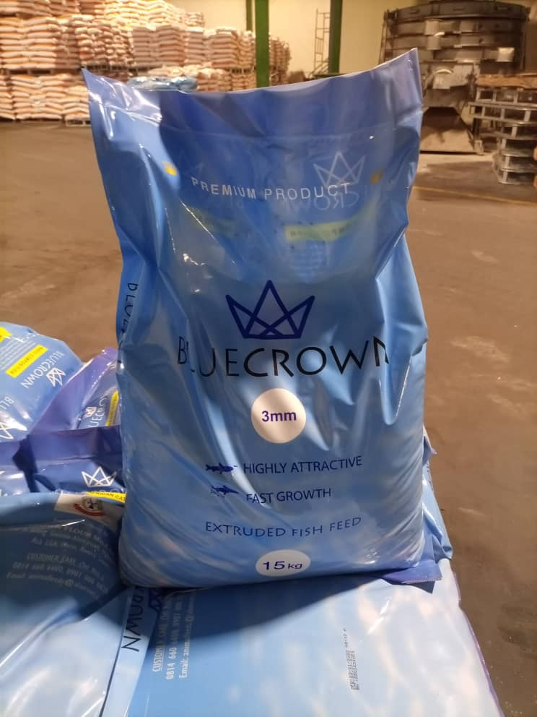
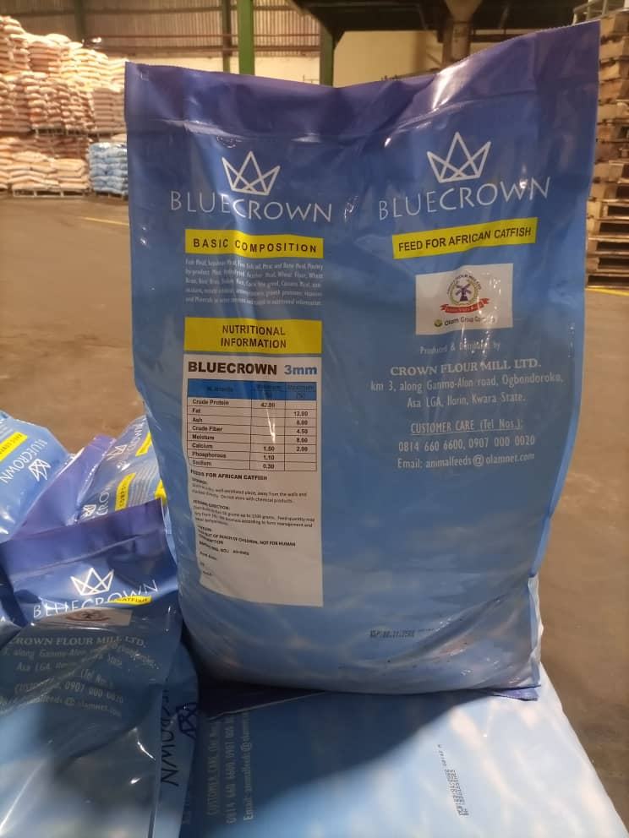
Category Code: 18
Bulk Packaging | 40 LDPE + 110 LDPE
Key Unique Process Lamination: PE + PE Surface Printing
POTENTIAL CUSTOMER NAME
OLAM AGRO - NIGERIA
ANMOL FEEDS PVT. LTD.
BAGADIYA BROTHERS PVT.LTD.

Slide 19
Thank You

